Slide 1


(a) Coherent and Incoherent Alternating Structure
(b) A coherent Set (CS)
Top
L₀
_CSet1_
ray optics
CS:1
EM wave optics
X
Z=0
Layer 1
$$d_{1}$$
L₁
_CSet2_
ray optics
Layer 2
$$d_{2}$$
Z=0
CS:2
EM wave optics
$$……$$
ray optics
$$……$$
EM wave optics
$$d_{i}$$
$$\hat{z}$$
$$\hat{z}$$
$$……$$
ray optics
$$……$$
_CSetn-1_
CS:n-1
EM wave optics
Layer m-1
$$d_{m−1}$$
Z=0
L_{n-1}
_CSetn_
ray optics
Layer m
$$d_{m}$$
X
CS:n
EM wave optics
Z=0
L_{n}
ray optics
Bottom

Slide 2




start
Load Material/User
start
Load Structure/Structure List
$$θ, φ$$
Top
Output setup (plot/write)
Calculate
$$λ$$
$$z$$
$$\frac{k_{x}}{k_{o}},\frac{k_{y}}{k_{o}}$$
Bottom
Incidence Type
field z distribution (external incidence)

Slide 3

start
Load Material/User
start
Load Structure/Structure List
$$θ, φ$$
Top
Output setup (plot/write)
Calculate
$$λ$$
$$z$$
$$\frac{k_{x}}{k_{o}},\frac{k_{y}}{k_{o}}$$
Bottom
Incidence Type
Incidence Direction
reflection/transmission coefficients

Slide 4
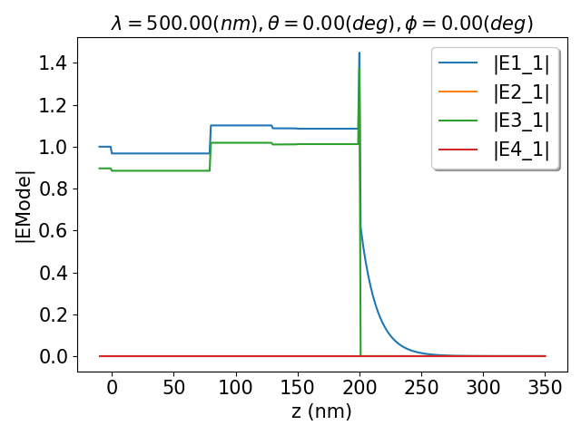
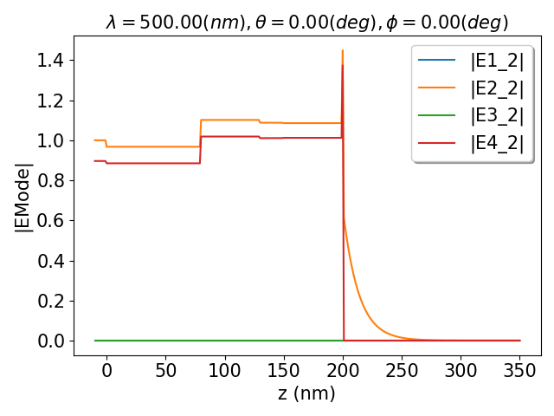
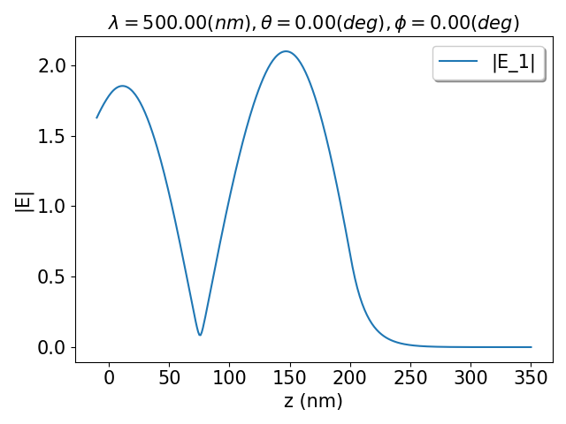

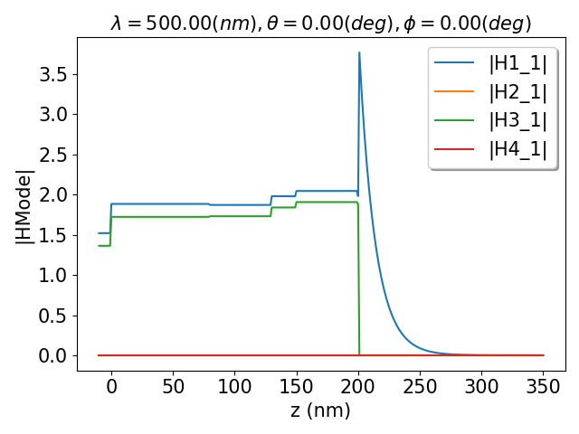
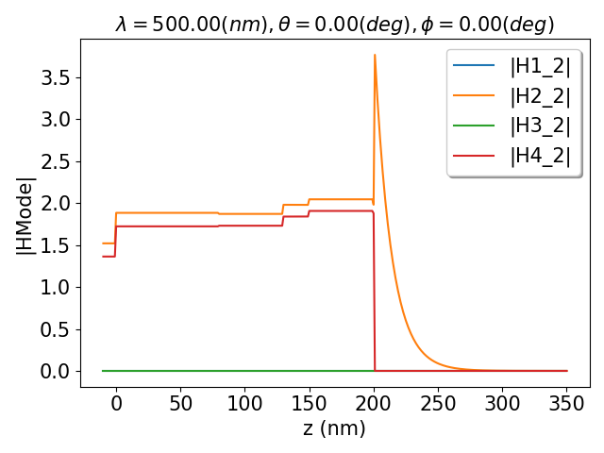
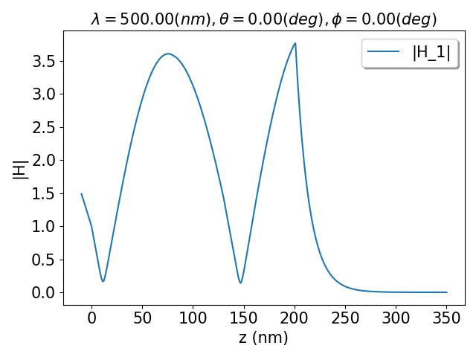

Electric Field
(a)
(b)
(c)
(d)
mode 1 incidence
mode 2 incidence
Magnetic Field
(e)
(f)
(g)
(h)
mode 1 incidence
mode 2 incidence

Slide 5
glass
ITO
TAPC
CBP
Al
B3PYMPM
air
Bottom

Slide 6
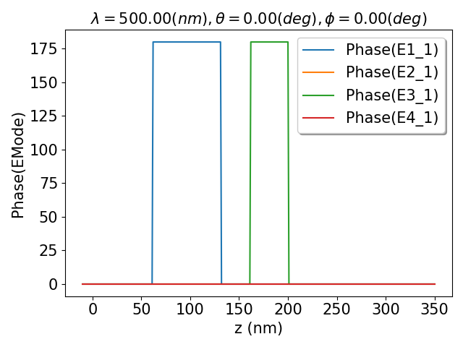
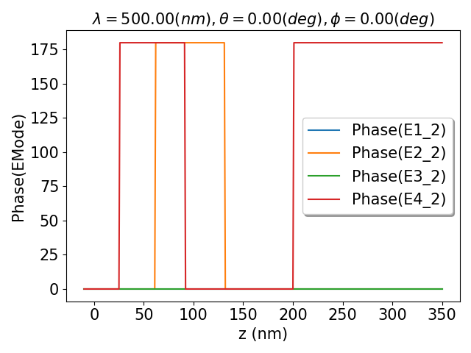
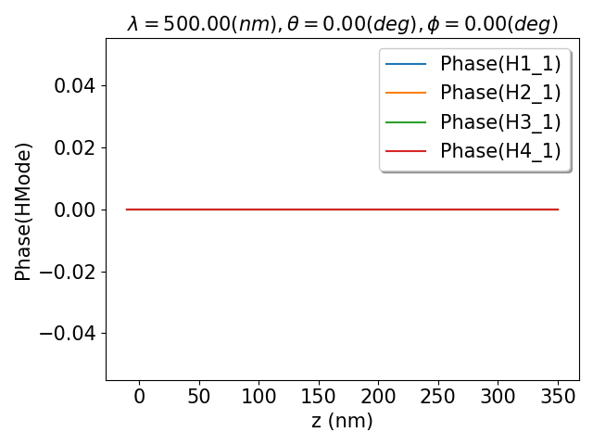

Electric Field
(a)
(b)
Magnetic Field
(c)
(d)

